Slide 1
Results of the week
Daniil Terebilenko
Junior DevOps Engineer

Slide 2
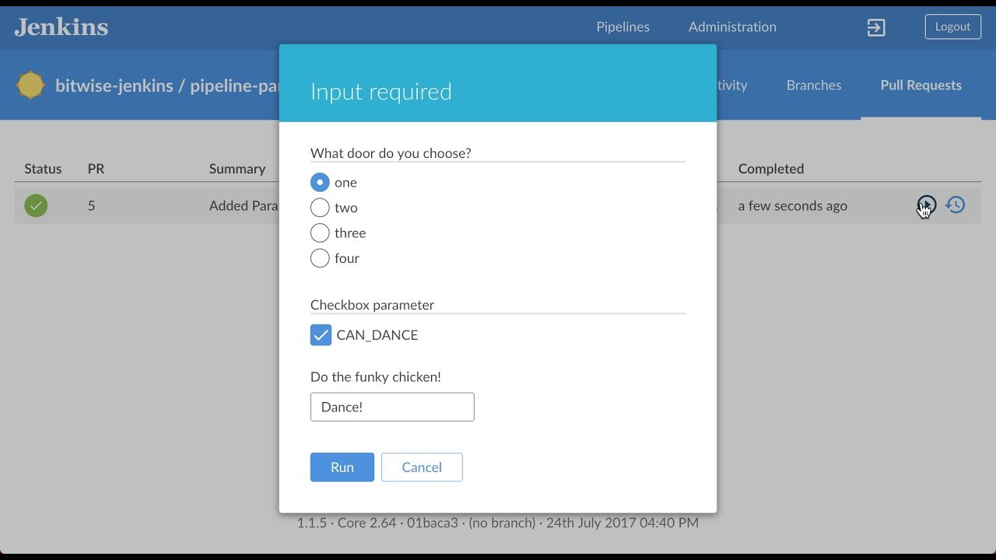
Jenkins pipeline with parameters

Slide 3
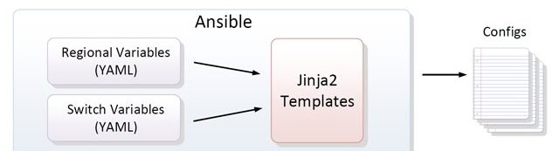
Ansible templates

Slide 4


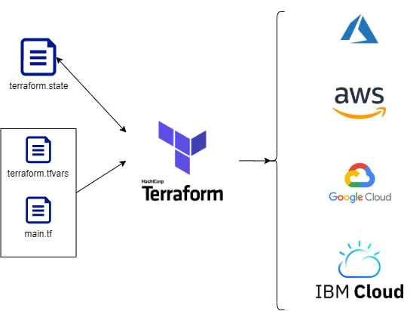
Terraform

